Slide 1


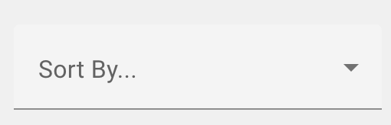
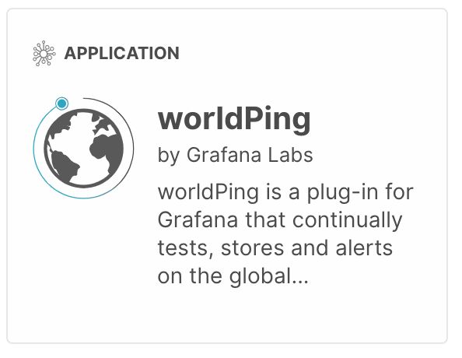

Submit App
Search Appstore
Categories
cat1
cat1
cat1
cat1
More>>>
<Previous Page 1 2 ……. 5 Next Page>
Notes:
This is Created keeping in mind lots of hardcoding of values in Appstore css code.
Search has been moved in a new location which make more sense for searching apps or app related content.
Sort by has been changed from tabs to drop down which seems to be how most websites seem to be doing like amazon.com or any other
The Reference to making the UI this way is
http://apps.cytoscape.org/
https://grafana.com/grafana/plugins?orderBy=weight&direction=asc
https://play.google.com/store?hl=en_US
The individual tiles of the apps would be operating in the way as pictured but with a shadow only on mouse hove event
The search Appstore would be as it but having an effect like being carved inwards
Sort by will be as is in the image
Categories is going to be similar to cytoscap with an outwords curve and a shadow around
The ratings for each app will be displayed default ….no additional content will be displayed on mouse hover since this can change the sizes depending on the additional content which can be unpredictable sometimes.
The submit button will be having some events like on hover, on click which will change the looks of the button
Sign in is removed to include an icon similar to https://www.nvidia.com/en-us/

Slide 2
Submit App
Search Appstore
Categories
cat1
cat1
cat1
cat1
cat1
cat1
cat1
cat1
More>>>
<Previous Page 1 2 ……. 5 Next Page>
Notes:
This UI is based on the old Card layout where the page is constructed with a div inside a div
The top and bottom edges of the card will remain rounded with a shadow that fades out.

